Slide 1
Session #3-4-5:
Markov Decision Processes ,
Dynamic Programming Solutions
Class 4: Returns, Policy and Value Iterations
Class 5: Optimal Policy and Value Functions

Slide 2
Agenda for the class
Agent-Environment Interface (Sequential Decision Problem)
MDP
Defining MDP,
Rewards,
Returns, Policy & Value Function,
Optimal Policy and Value Functions
Approaches to solve MDP

Slide 3
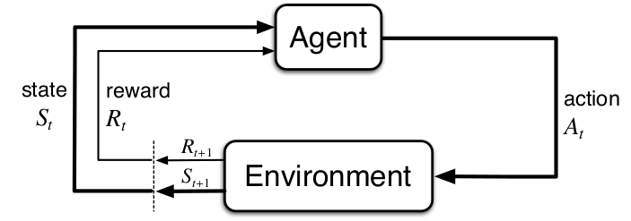
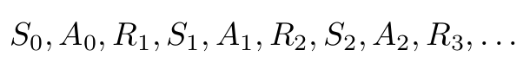
Agent-Environment Interface
Agent - Learner & the decision maker
Environment - Everything outside the agent
Interaction:
Agent performs an action
Environment responds by
presenting a new situation (change in state)
presents numerical reward
Objective (of the interaction):
Maximize the return (cumulative rewards) over time
Note:
Interaction occurs in discrete time steps

Slide 4
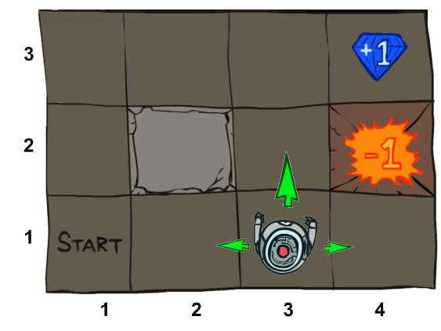
Grid World Example
A maze-like problem
The agent lives in a grid
Walls block the agent’s path
Noisy movement: actions do not always go as planned
80% of the time, the action North takes the agent North (if there is no wall there)
10% of the time, North takes the agent West; 10% East
If there is a wall in the direction the agent would have been taken, the agent stays put
The agent receives rewards each time step
-0.1 per step (battery loss)
+1 if arriving at (4,3) ; -1 for arriving at (4,2) ;1 for arriving at (2,2)
Goal: maximize accumulated rewards

Slide 5
Markov Decision Processes
An MDP is defined by
A set of states
A set of actions
State-transition probabilities
Probability of arriving to after performing at
Also called the model dynamics
A reward function
The utility gained from arriving to after performing at
Sometimes just or even
A start state
Maybe a terminal state

Slide 6
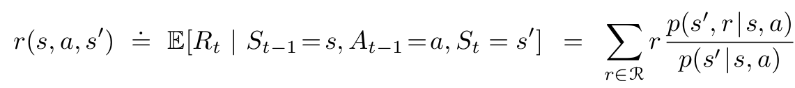
Markov Decision Processes
Model Dynamics
State-transition probabilities
Expected rewards for state–action–next-state triples

Slide 7
Markov Decision Processes - Discussion
MDP framework is abstract and flexible
Time steps need not refer to fixed intervals of real time
The actions can be
at low-level controls or high-level decisions
totally mental or computational
States can take a wide variety of forms
Determined by low-level sensations or high-level and abstract (ex. symbolic descriptions of objects in a room)
The agent–environment boundary represents the limit of the agent’s absolute control, not of its knowledge.
The boundary can be located at different places for different purposes

Slide 8
Markov Decision Processes - Discussion
MDP framework is a considerable abstraction of the problem of goal-directed learning from interaction.
It proposes that whatever the details of the sensory, memory, and control apparatus, and whatever objective one is trying to achieve, any problem of learning goal-directed behavior can be reduced to three signals passing back and forth between an agent and its environment:
one signal to represent the choices made by the agent (the actions)
one signal to represent the basis on which the choices are made (the states),
and one signal to define the agent’s goal (the rewards).

Slide 9
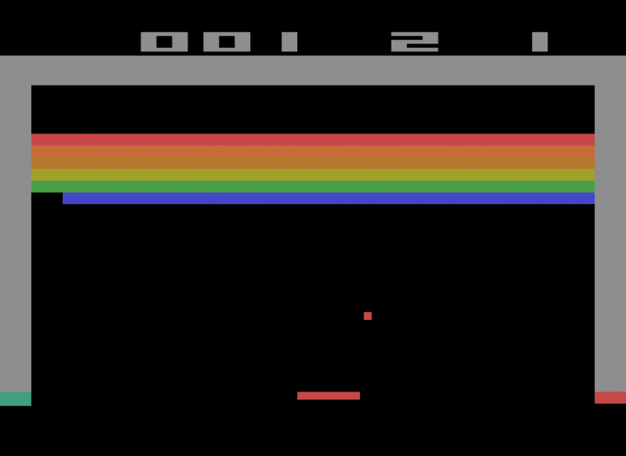
MDP Formalization : Video Games
State:
raw pixels
Actions:
game controls
Reward:
change in score
State-transition probabilities:
defined by stochasticity in game evolution
Ref: Playing Atari with deep reinforcement learning”, Mnih et al., 2013

Slide 10
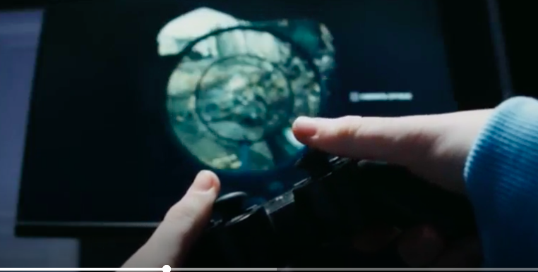

Game Controls(Actions):
Move paddle left
Move paddle right
(Potentially) Launch ball (at the start of a round)
(Potentially) No-op (do nothing)
Rewards:
Positive(hit a brick, score increase)
Negative(losing life or fail to hit ball or end the game)
Model Dynamics: p(s', r | s, a)
p(frame with brick removed, +10 score change∣ current frame, move paddle right)
State Transition Prob: Sum of all p(s' | s , a) possible rewards R.
Expected Rewards: (r (s, a, s'))
r(current frame, move right, frame with ball hitting brick)

Slide 11
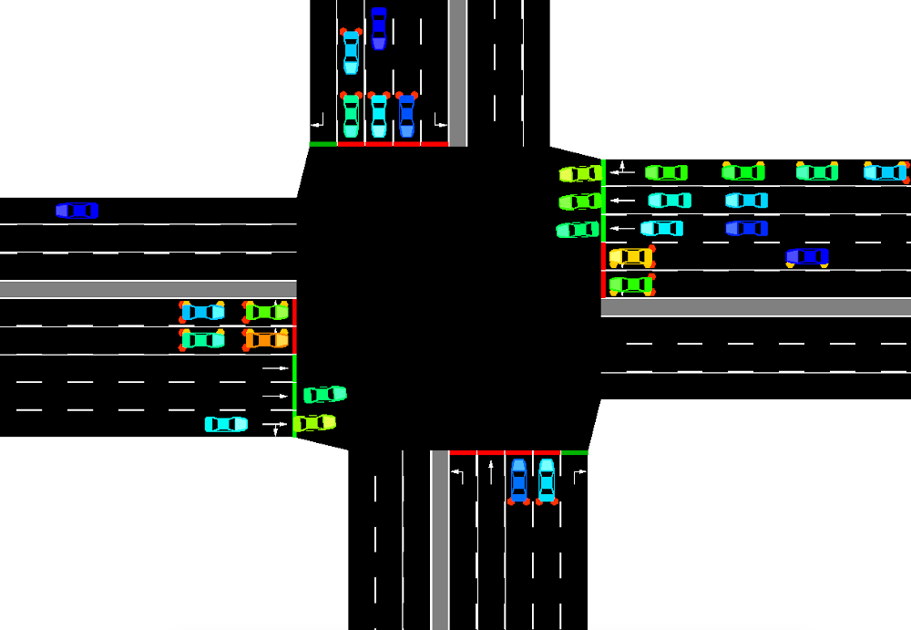
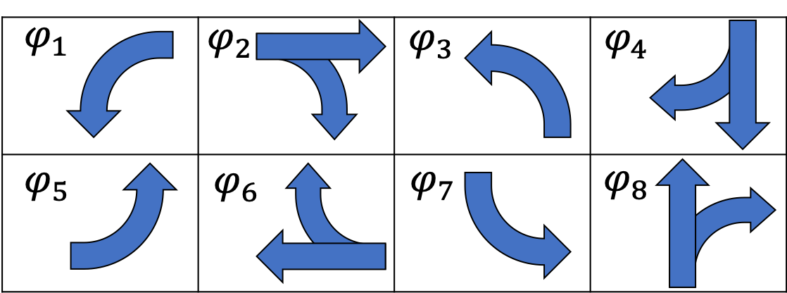
MDP Formalization : Traffic Signal Control
State:
Current signal assignment (green, yellow, and red assignment for each phase)
For each lane: number of approaching vehicles, accumulated waiting time, number of stopped vehicles, and average speed of approaching vehicles
Actions:
signal assignment
Reward:
Reduction in traffic delay
State-transition probabilities:
defined by stochasticity in approaching demand
Ref: “Learning an Interpretable Traffic Signal Control Policy”, Ault et al., 2020

Slide 12

MDP Formalization : Recycling Robot (Detailed Ex.)
Robot has
sensors for detecting cans
arm and gripper that can pick the cans and place in an onboard bin;
Runs on a rechargeable battery
Its control system has components for interpreting sensory information, for navigating, and for controlling the arm and gripper
Task for the RL Agent: Make high-level decisions about how to search for cans based on the current charge level of the battery

Slide 13
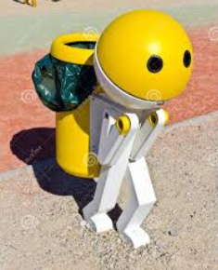
MDP Formalization : Recycling Robot (Detailed Ex.)
State:
Assume that only two charge levels can be distinguished
S = {high, low}
Actions:
A(high) = {search, wait}
A(low) = {search, wait, recharge}
Reward:
Zero most of the time, except when securing a can
Cans are secured by searching and waiting, but r_{search} > r_{wait}
State-transition probabilities:
[Next Slide]

Slide 14
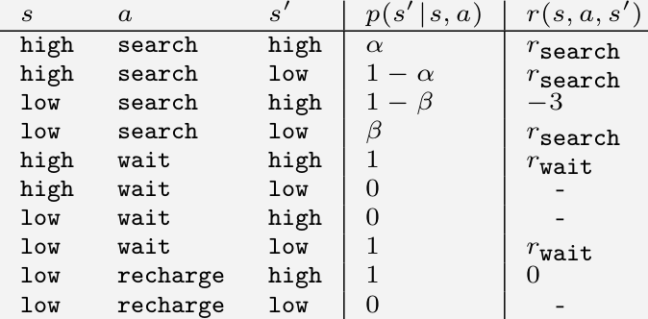
MDP Formalization : Recycling Robot (Detailed Ex.)
State-transition probabilities (contd…):

Slide 15
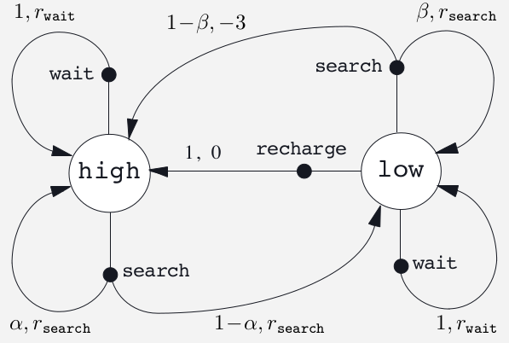
MDP Formalization : Recycling Robot (Detailed Ex.)
State-transition probabilities (contd…):

Slide 16
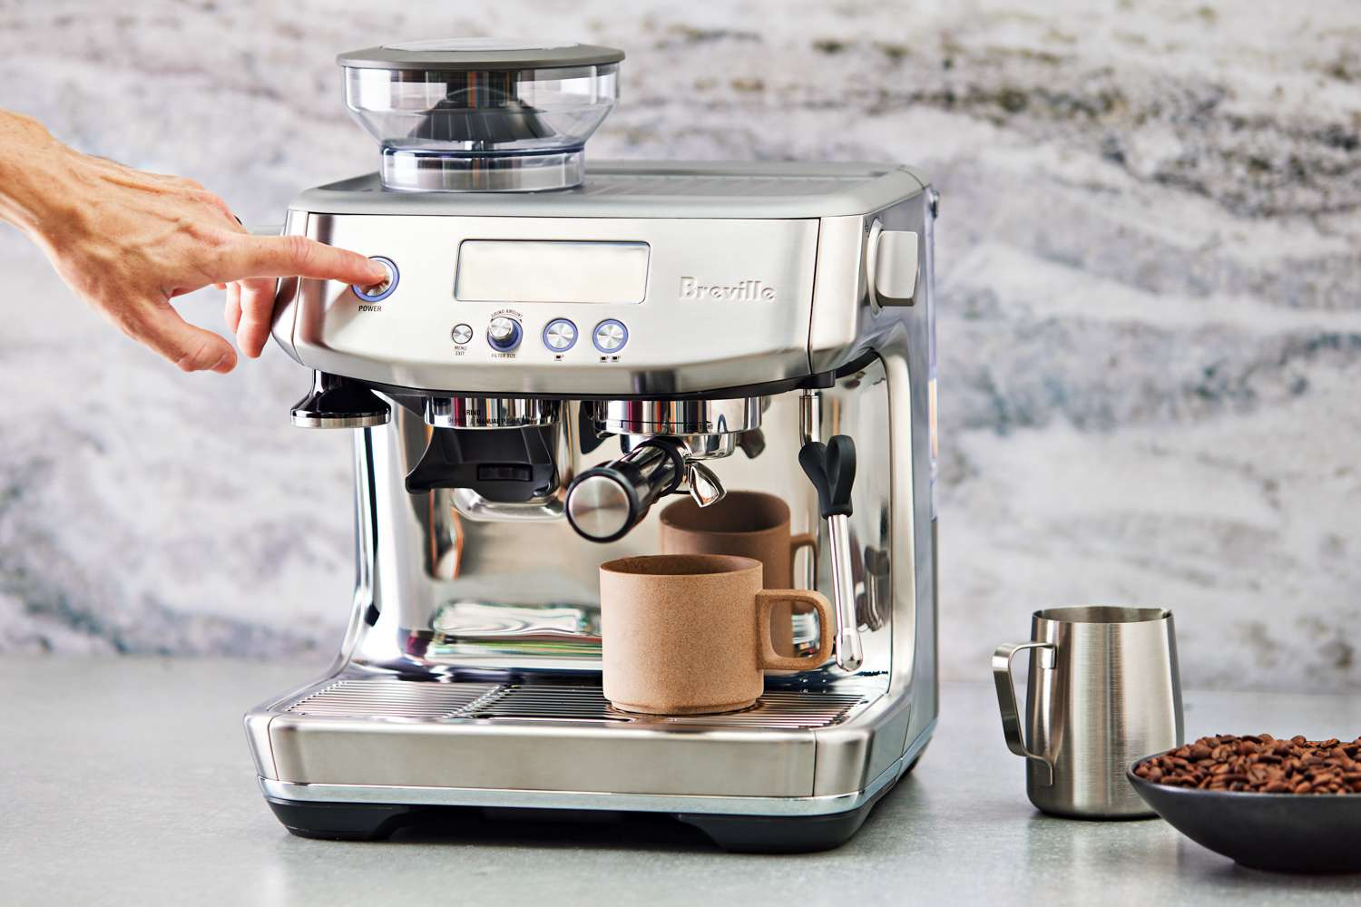
Problem : The "Smart" Coffee Machine
Scenario: You have a smart coffee machine at home.
You want to program it to maximize your satisfaction throughout the morning.
Its performance is affected by its maintenance level and your desired coffee strength.
Machine's Goal: Maximize your "satisfaction points" (reward).
MDP Components:
States (S):
Clean: Machine is recently cleaned and well-maintained.
Dirty: Machine needs cleaning, might affect coffee quality.
Actions (A):
Brew_Strong: Try to brew a strong coffee.
Brew_Mild: Try to brew a mild coffee.
Clean_Machine: Perform a cleaning cycle.
Rewards (R):
+5: Perfect strong coffee.
+3: Decent strong coffee.
+2: Perfect mild coffee.
+1: Decent mild coffee.
-1: Weak/bad coffee.
-3: Machine breaks down (severe penalty).
0: Cleaning cycle (no direct satisfaction,
but enables future good coffee).

Slide 17
Current State (s) | Action (a) | Next State (s′) | Reward (r) | Probability p(s′,r∣ s,a) |
Clean | Brew_Strong | Clean | +5 | 0.7 |
Clean | Brew_Strong | Dirty | +3 | 0.3 |
Clean | Brew_Mild | Clean | +2 | 0.8 |
Clean | Brew_Mild | Dirty | +1 | 0.2 |
Clean | Clean_Machine| Clean | 0 | 1.0 |
Dirty | Brew_Strong | Dirty | +3 | 0.2 |
Dirty | Brew_Strong | Dirty | -1 | 0.6 |
Dirty | Brew_Strong | Dirty | -3 | 0.2 |
Dirty | Brew_Mild | Dirty | +1 | 0.5 |
Dirty | Brew_Mild | Dirty | -1 | 0.5 |
Dirty | Clean_Machine| Clean | 0 | 1.0 |
Task 1: Calculate State Transition Probabilities (p(s′∣s,a))
Using the Model Dynamics table, calculate the probability of transitioning to each next state for the following (state, action) pairs. Remember that p(s′∣s,a)=∑r∈R p(s′,r∣s,a).
Current State: Dirty, Action: Brew_Strong
p(Dirty} | Dirty, Brew_Strong)
Current State: Clean, Action: Brew_Mild
p(Clean} | Clean, Brew_Mild)
p(Dirty} | Clean, Brew_Mild)
Task 2: Calculate Expected Rewards for State-Action-Next-State Triples (r(s,a,s′))
Using the Model Dynamics table and the p(s′∣s,a) values you (or we) calculate, determine the expected reward for the following specific transitions. Remember the formula:
r(s,a,s′)=∑r∈R r⋅p(s′,r ∣ s,a) / p(s' | s, a)
Transition: From Dirty state, take Brew_Strong action, and end up in Dirty state.
r(Dirty, Brew_Strong, Dirty)

Slide 18
Solution for Task 1: Calculating State Transition Probabilities
Current State: Dirty, Action: Brew_Strong
We need p(Dirty | Dirty, Brew_Strong).
Looking at the Model Dynamics table for (Dirty, Brew_Strong):
(Dirty, +3) with probability 0.2
(Dirty, -1) with probability 0.6
(Dirty, -3) with probability 0.2
Since all transitions from (Dirty, Brew_Strong) lead to Dirty as the next state, we sum their probabilities:
p(Dirty | Dirty, Brew_Strong) = 0.2 + 0.6 + 0.2 = 1.0 (This makes sense; if the machine is dirty and you try to brew strong, it will remain dirty, though the outcome (reward) varies.)
Current State: Clean, Action: Brew_Mild
p(Clean | Clean, Brew_Mild) = p(Clean, +2 | Clean, Brew_Mild) = 0.8
p(Dirty | Clean, Brew_Mild) = p(Dirty, +1 | Clean, Brew_Mild) = 0.2
(Check: 0.8+0.2=1.0. The probabilities for all possible next states sum to 1 for this (s,a) pair).

Slide 19
Solution for Task 2: Calculating Expected Rewards for State-Action-Next-State Triples
Transition: From Dirty state, take Brew_Strong action, and end up in Dirty state.
r(Dirty, Brew_Strong, Dirty)
First, we need p(Dirty | Dirty, Brew_Strong), which we calculated in Task 1 as 1.0.
Now, identify all (s′,r) pairs from the Model Dynamics table for
s = Dirty, a = Brew_Strong, and s' = Dirty:
(Dirty, +3) with probability 0.2
(Dirty, -1) with probability 0.6
(Dirty, -3) with probability 0.2
Apply the formula: r(Dirty, Brew_Strong, Dirty) =
((3*0.2)+(-1*0.6)+(-3*0.2))/1.0 = −0.6

Slide 20
Note on Goals & Rewards
Reward Hypothesis:
All of what we mean by goals and purposes can be well thought of as the maximization of the expected value of the cumulative sum of a received scalar signal (called reward).
The rewards we set up truly indicate what we want accomplished,
not the place to impart prior knowledge on how we want it to do
Ex: Chess Playing Agent
If the agent is rewarded for taking opponents pieces, the agent might fall for the opponent's trap.
Ex: Vacuum Cleaner Agent
If the agent is rewarded for each unit of dirt it sucks, it can repeatedly deposit and suck the dirt for larger reward

Slide 21
Returns & Episodes
Goal is to maximize the expected return
Return (Gt) is defined as some specific function of the reward sequence
Episodic tasks vs. Continuing tasks
When there is a notion of final time step, say T, return can be
Applicable when agent-environment interaction breaks into episodes
Ex: Playing Game, Trips through maze etc. [ called episodic tasks]

Slide 22
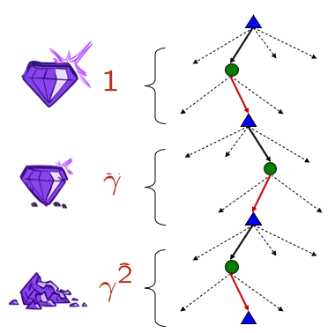
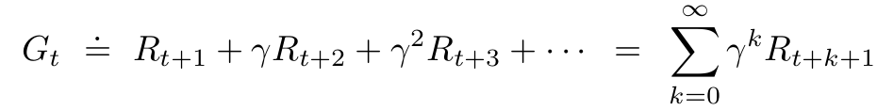
Returns & Episodes
Generally T = ∞
What if the agent receive a reward of +1 for each timestep?
Discounted Return:
Discount rate determines the present value of future rewards
Note:

Slide 23
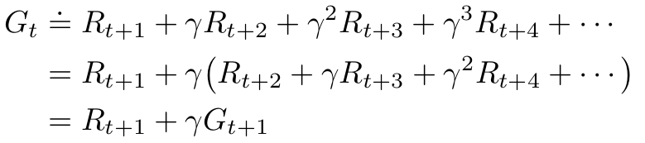
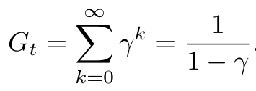
Returns & Episodes
What if 𝛾 is 0?
What if 𝛾 is 1?
Computing discounted rewards incrementally
Sum of an infinite number of terms, it is still finite if the reward is nonzero and constant and if 𝛾 < 1.
Ex: reward is +1 constant

Slide 24
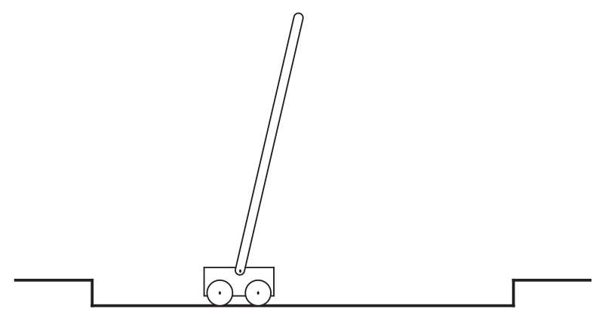
Returns & Episodes
Objective: To apply forces to a cart moving along a track so as to keep a pole hinged to the cart from falling over
Discuss:
Consider the task as episodic, that is try/maintain balance until failure. What could be the reward function?
Repeat prev. assuming task is continuous.

Slide 25
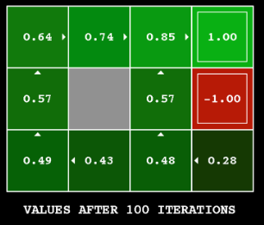
Policy
A mapping from states to probabilities of selecting each possible action.
𝛑 (a|s) is the probability that A_{t} = a if S_{t} = s
The purpose of learning is to improve the agent's policy with its experience

Slide 26
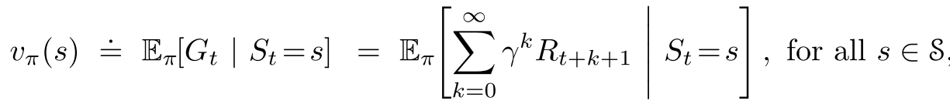
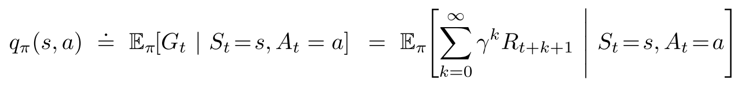
Defining Value Functions
State-value function for policy 𝝿
Action-value function for policy 𝝿

Slide 27
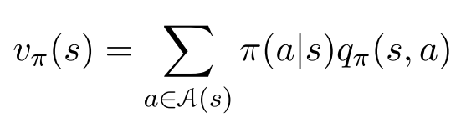
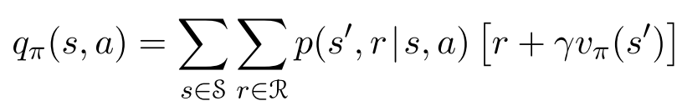
Defining Value Functions
State Value function in terms of Action-value function for policy 𝝿
Action Value function in terms of State value function for policy 𝝿

Slide 28
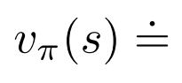
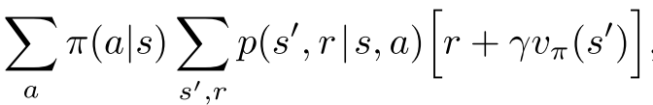
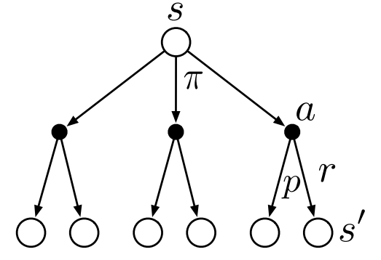
Bellman Equation for V_{𝝅}
Value of the start state must equal
the (discounted) value of the expected next state,
plus
the reward expected along the way
Backup Diagram

Slide 29
Class #3 ends

Slide 30
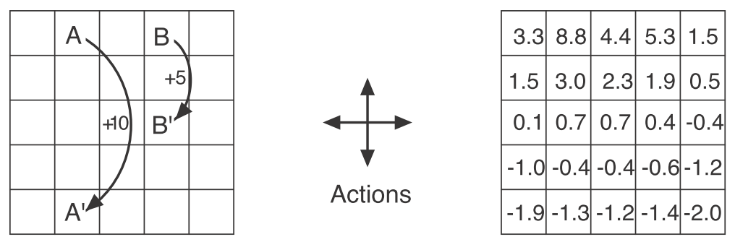
Understanding V_{𝝅}(s) with Gridworld
Reward:
-1 if an action takes agent off the grid
Exceptional reward from A and B for all actions taking agent to A’ and B’ resp.
0, everywhere else
Exceptional reward dynamics
State-value function for the equiprobable random policy with 𝛾 = 0.9

Slide 31
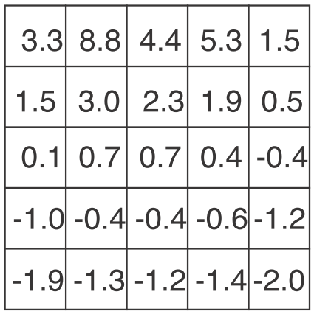
Understanding V_{𝝅}(s) with Gridworld
Verify V_{𝝅}(s) using Bellman equation for this state with 𝛾 = 0.9, and equiprobable random policy

Slide 32
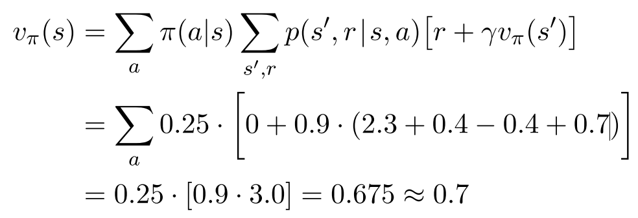
Understanding V_{𝝅}(s) with Gridworld

Slide 33
Ex-1
Recollect the reward function used for Gridworld as below:
-1 if an action takes agent off the grid
Exceptional reward from A and B for all actions taking agent to A’ and B’ resp.
0, everywhere else
Let us add a constant c ( say 10) to the rewards of all the actions. Will it change anything?

Slide 34
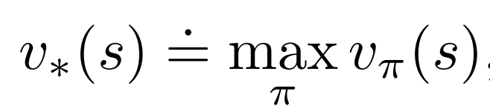
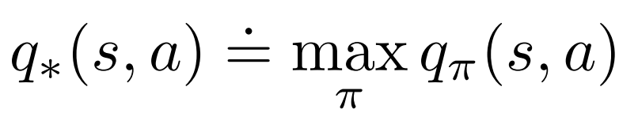
Optimal Policies and Optimal Value Functions
𝝿 ≥ 𝝿’ if and only if v_{𝝿}(s) ≥ v_{𝝿}(s) for all s ∊ S
There is always at least one policy that is better than or equal to all other policies → optimal policy (denoted as 𝝿*)
There could be more than one optimal policy !!!
Optimal state-value function
Optimal action-value function

Slide 35
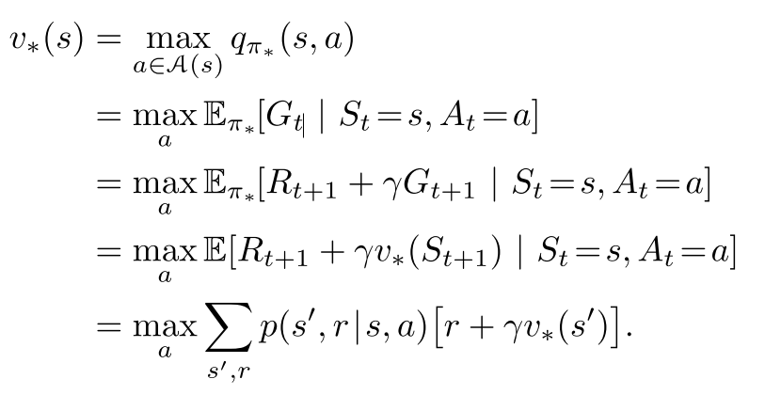
Optimal Policies and Optimal Value Functions
Bellman optimality equation - expresses that the value of a state under an optimal policy must equal the expected return for the best action from that state
Bellman optimality equation for V*

Slide 36
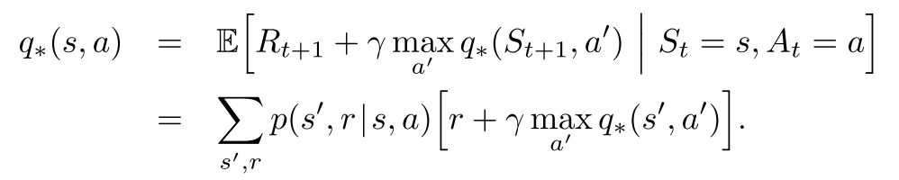
Optimal Policies and Optimal Value Functions
Bellman optimality equation - expresses that the value of a state under an optimal policy must equal the expected return for the best action from that state
Bellman optimality equation for q*

Slide 37
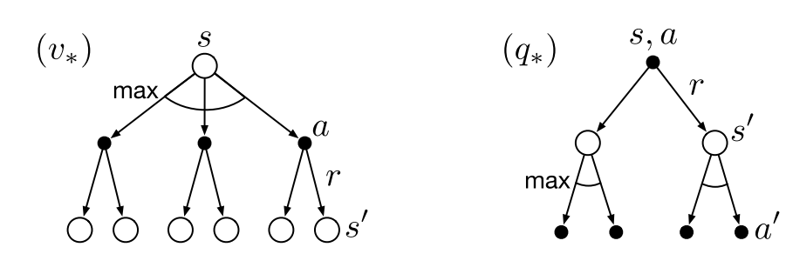
Optimal Policies and Optimal Value Functions
Bellman optimality equation - expresses that the value of a state under an optimal policy must equal the expected return for the best action from that state
Backup diagrams for v* and q*

Slide 38
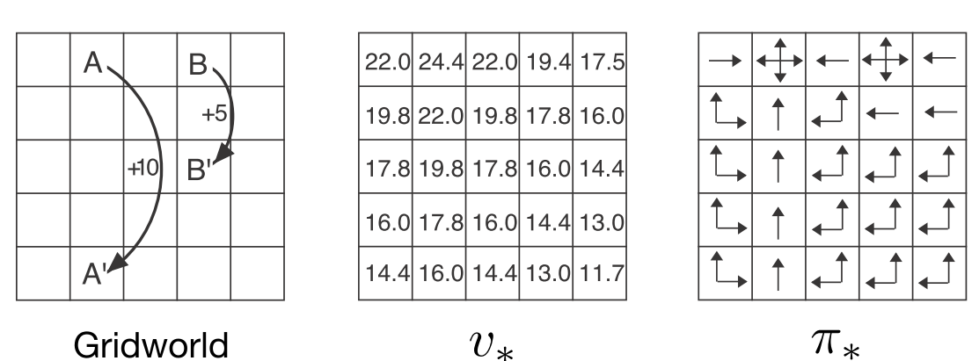
Optimal solutions to the gridworld example
Backup diagrams for v* and q*

Slide 39

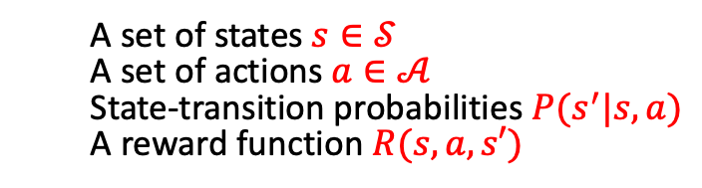
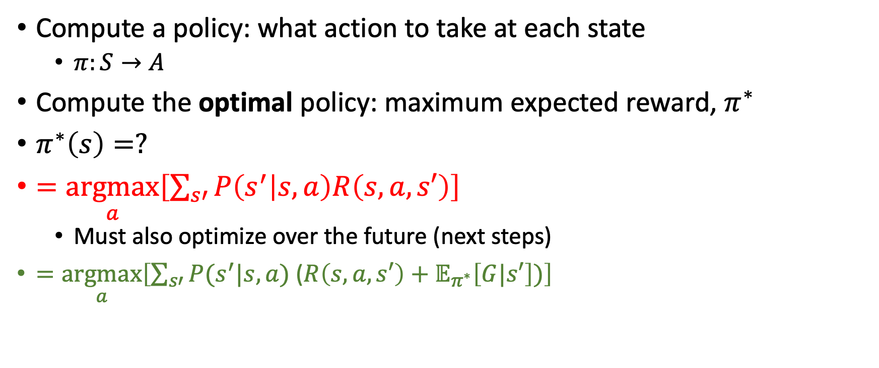
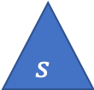
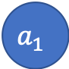
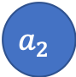
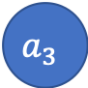
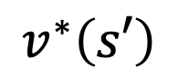
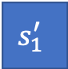
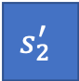
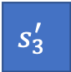
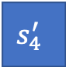

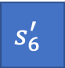
MDP - Objective

Slide 40
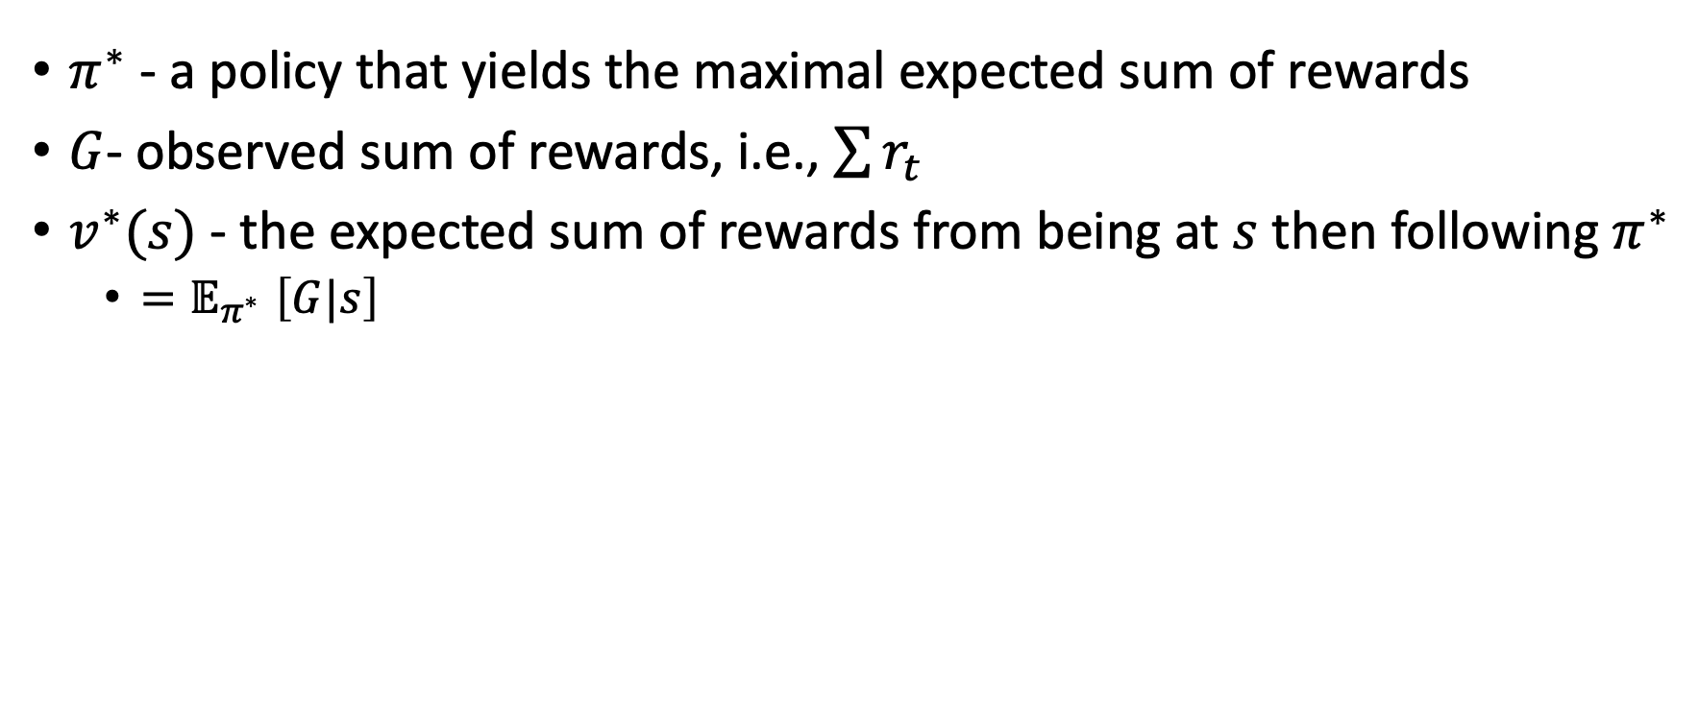
Notation

Slide 41
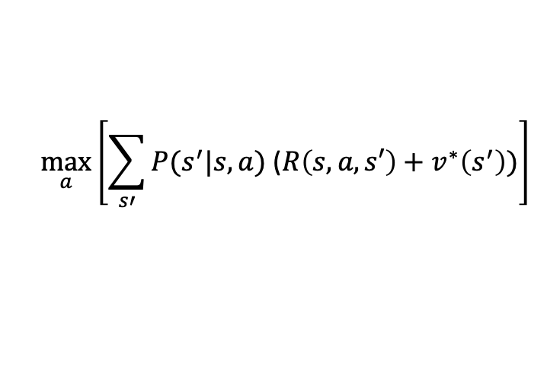
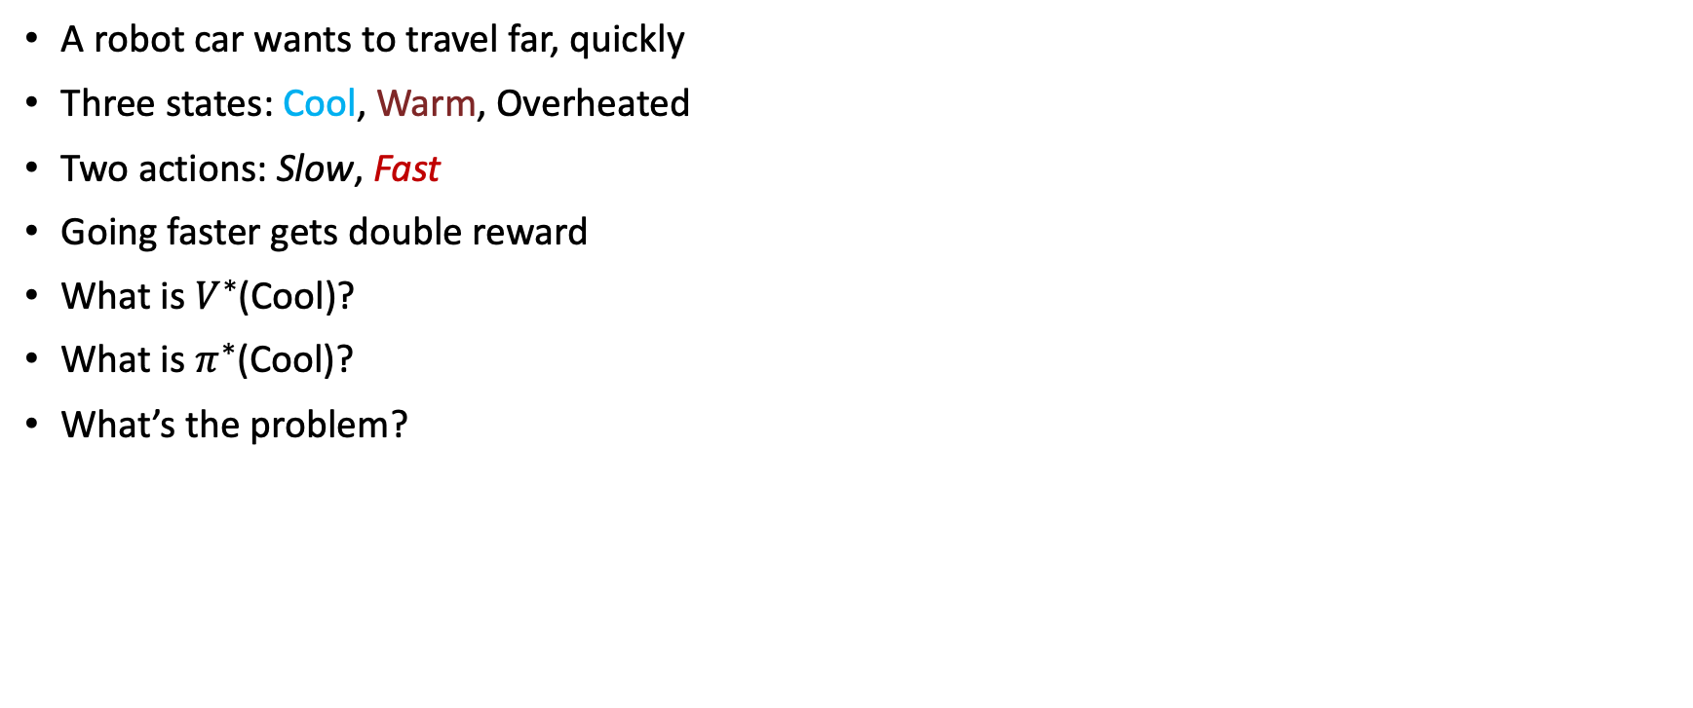
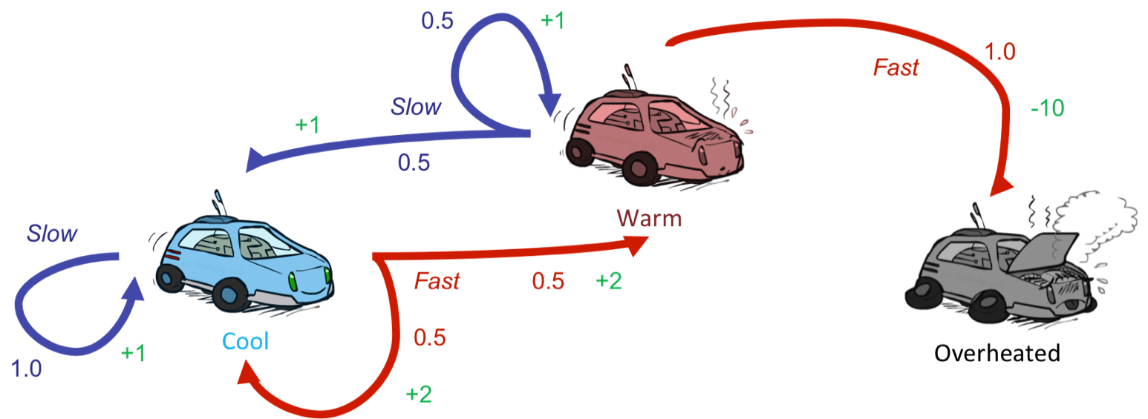
Race car example

Slide 42


Infinite Utilities?!
Problem: What if the game lasts forever? Do we get infinite rewards?
Solutions:
Finite horizon: (similar to depth-limited search)
Terminate episodes after a fixed T steps (e.g. life)
Gives nonstationary policies (π depends on time left)
Discounting: use 0 < γ < 1
Smaller γ means smaller “horizon” – shorter term focus

Slide 43



Discount factor
Geometric series

Slide 44





Discounting
It’s reasonable to maximize the sum of rewards
It’s also reasonable to prefer rewards now to rewards later
Discount factor: values of rewards decay exponentially
Worth Now
Worth Next Step
Worth In Two Steps

Slide 45

Discounting
How to discount?
Each time we descend a level, we multiply in the discount once
Why discount?
Sooner rewards probably do have higher utility than later rewards
Also helps our algorithms converge
Example: discount of 0.5
G(r=[1,2,3]) = 1*1 + 0.5*2 + 0.25*3
G([1,2,3]) < G([3,2,1])
Notes:
Rewards in the future (deeper in the tree) matter less
Interesting: running expectimax, if having to truncate the search, then not losing much; e.g., less then \gamma^d / (1-\gamma)

Slide 46



Quiz: Discounting
Given grid world:
Actions: East, West, and Exit (‘Exit’ only available in terminal states: a, e)
Rewards are given only after an exit action
Transitions: deterministic
Quiz 1: For γ = 1, what is the optimal policy?
Quiz 2: For γ = 0.1, what is the optimal policy?
Quiz 3: For which γ are West and East equally good when in state d?

Slide 47

Race car example

Slide 48

Value iteration

Slide 49









Value Iteration
0 0 0
2 1 0
3.35 2.35 0
Check this computation on paper.

Slide 50
V2​ (After 2nd Iteration - k=2):
Cool: 3.35 (highlighted)
Warm: 2.35
Overheated: 0
Let's check the computation for V2​ using V1​=[2,1,0] and γ=0.9:
For V2​(Cool):
Action Slow: 1.0×(1+0.9×V1​(Cool))=1×(1+0.9×2)=1+1.8=2.8
Action Fast:
0.5×(2+0.9×V1​(Cool))+0.5×(2+0.9×V1​(Warm))
=0.5×(2+0.9×2)+0.5×(2+0.9×1)
=0.5×(2+1.8)+0.5×(2+0.9)
=0.5×3.8+0.5×2.9=1.9+1.45=3.35
V2​(Cool)=max(2.8,3.35)=3.35.
For V2​(Warm):
Action Slow:
0.5×(1+0.9×V1​(Cool))+0.5×(1+0.9×V1​(Warm))
=0.5×(1+0.9×2)+0.5×(1+0.9×1)
=0.5×(1+1.8)+0.5×(1+0.9)
=0.5×2.8+0.5×1.9=1.4+0.95=2.35
Action Fast:
0.5×(2+0.9×V1​(Warm))+0.5×(−10+0.9×V1​(Overheated))
=0.5×(2+0.9×1)+0.5×(−10+0.9×0)
=0.5×(2+0.9)+0.5×(−10)
=0.5×2.9−5=1.45−5=−3.55
V2​(Warm)=max(2.35,−3.55)=2.35. (This matches the slide).
For V2​(Overheated): Still 0.
V0​ (Initial Values - k=0):
Cool: 0
Warm: 0
Overheated: 0
V1​ (After 1st Iteration - k=1):
Cool: 2
Warm: 1
Overheated: 0 (remains 0)
Let's check the calculations for V1​ using V0​=[0,0,0] and γ=0.9:
For V1​(Cool):
Action Slow: 1.0×(1+0.9×V0​(Cool))=1×(1+0.9×0)=1
Action Fast:
0.5×(2+0.9×V0​(Cool))+0.5×(2+0.9×V0​(Warm))
=0.5×(2+0.9×0)+0.5×(2+0.9×0)
=0.5×2+0.5×2=1+1=2
V1​(Cool)=max(1,2)=2. (This matches the slide).
For V1​(Warm):
Action Slow:
0.5×(1+0.9×V0​(Cool))+0.5×(1+0.9×V0​(Warm))
=0.5×(1+0.9×0)+0.5×(1+0.9×0)
=0.5×1+0.5×1=0.5+0.5=1
Action Fast:
0.5×(2+0.9×V0​(Warm))+0.5×(−10+0.9×V0​(Overheated))
=0.5×(2+0.9×0)+0.5×(−10+0.9×0)
=0.5×2+0.5×(−10)=1−5=−4
V1​(Warm)=max(1,−4)=1.
For V1​(Overheated): As it's a terminal or highly penalized state, it remains 0.

Slide 51







Example: Grid World
A maze-like problem
The agent lives in a grid
Walls block the agent’s path
Noisy movement: actions do not always go as planned
80% of the time, the action North takes the agent North
10% of the time, North takes the agent West; 10% East
If there is a wall in the direction the agent would have been taken, the agent stays put
The agent receives rewards each time step
Small negative reward each step (battery drain)
Big rewards come at the end (good or bad)
Goal: maximize sum of (discounted) rewards
Notes:
[cut demo of moving around in grid world program]

Slide 52

k=0
Noise = 0.2
Discount = 0.9
Living reward = 0
Notes:
Assuming zero living reward

Slide 53

k=1
Noise = 0.2
Discount = 0.9
Living reward = 0
Notes:
Assuming zero living reward

Slide 54

k=2
Noise = 0.2
Discount = 0.9
Living reward = 0
Notes:
Assuming zero living reward

Slide 55

k=3
Noise = 0.2
Discount = 0.9
Living reward = 0
Notes:
Assuming zero living reward

Slide 56

k=4
Noise = 0.2
Discount = 0.9
Living reward = 0
Notes:
Assuming zero living reward

Slide 57

k=5
Noise = 0.2
Discount = 0.9
Living reward = 0
Notes:
Assuming zero living reward

Slide 58

k=6
Noise = 0.2
Discount = 0.9
Living reward = 0
Notes:
Assuming zero living reward

Slide 59

k=7
Noise = 0.2
Discount = 0.9
Living reward = 0
Notes:
Assuming zero living reward

Slide 60

k=8
Noise = 0.2
Discount = 0.9
Living reward = 0
Notes:
Assuming zero living reward

Slide 61

k=9
Noise = 0.2
Discount = 0.9
Living reward = 0
Notes:
Assuming zero living reward

Slide 62

k=10
Noise = 0.2
Discount = 0.9
Living reward = 0
Notes:
Assuming zero living reward

Slide 63

k=11
Noise = 0.2
Discount = 0.9
Living reward = 0
Notes:
Assuming zero living reward

Slide 64

k=12
Noise = 0.2
Discount = 0.9
Living reward = 0
Notes:
Assuming zero living reward

Slide 65

k=100
Noise = 0.2
Discount = 0.9
Living reward = 0
Notes:
Assuming zero living reward

Slide 66

Problems with Value Iteration
Notes:
Demo steps through value iteration; snapshots of values shown on next slides.

Slide 67

Solutions (briefly, more later…)

Slide 68

Asynchronous value iteration
In value iteration, we update every state in each iteration
Actually, any sequences of Bellman updates will converge if every state is visited infinitely often regardless of the visitation order
Idea: prioritize states whose value we expect to change significantly

Slide 69



Asynchronous Value Iteration
Which states should be prioritized for an update?
A single update per iteration

Slide 70


Double the work?

Slide 71

Issue 2: A policy cannot be easily extracted

Slide 72
End of class #4

Slide 73


Q-learning

Slide 74

Q-learning as value iteration

Slide 75

Issue 3: The policy often converges long before the values

Slide 76


Policy Iteration

Slide 77

Policy Evaluation

Slide 78


Policy value as a Linear program
Given X₀ + 2X₁= 1
3X₀ + 5X₁ = 2
>>import numpy as np
>>a = np.array([[1, 2], [3, 5]])
>>b = np.array([1, 2])
>>x = np.linalg.solve(a, b)
>>x
Array([-1, 1])
Notes:
[cut demo of moving around in grid world program]

Slide 79


Policy iteration
0.7
0.8
0.9
0.7
0.6
0.4
0.6
0.5

Slide 80
Comparison
Both value iteration and policy iteration compute the same thing (optimal state values)
In value iteration:
Every iteration updates both the values and (implicitly) the policy
We don’t track the policy, but taking the max over actions implicitly define it
In policy iteration:
We do several passes that update utilities with fixed policies (each pass is fast because we consider only one action, not all of them)
After the policy is evaluated, a new policy is chosen (slow like a value iteration pass)
The new policy will be better (or we’re done)

Slide 81



Issue 4: requires knowing the model and the reward function
Offline optimization
Online Learning

Slide 82
Issue 5: requires discrete (finite) set of actions
We will explore policy gradient approaches that are suitable for continuous actions, e.g., throttle and steering for a vehicle
Can such approaches be relevant for discrete action spaces?
Yes! We can always define a continues action space as a distribution over the discreate actions (e.g., using the softmax function)
Can we combine value-based approaches and policy gradient approaches and get the best of both?
Yes! Actor-critic methods

Slide 83
Issue 6: infeasible in large (or continues) state spaces
Most real-life problems contain very large state spaces (practically infinite)
It is infeasible to learn and store a value for every state
Moreover, doing so is not useful as the chance of encountering a state more than once is very small
We will learn to generalize our learning to apply to unseen states
We will use value function approximators that can generalize the acquired knowledge and provide a value to any state (even if it was not previously seen)

Slide 84

Notation

Slide 85
Required Readings
Chapter-3,4 of Introduction to Reinforcement Learning,2nd Ed., Sutton & Barto

Slide 86
Thank you

